Slide 1


COURSE MANAGEMENT SYSTEM
NO. OF MEMEBERS : 3
DETAILS OF MEMBERS : SUJAN KUMAR M V(20MIC0084)
PALLE LAHARI(20MIC0078)
SARAGA S(20MIC0081)
LANGUAGE USED : PYTHON

Slide 2

INTRODUCTION
Course Management System can be used by education institutes to maintain the records of the courses selected by students easily.
Achieving this objective is difficult using manual system as the information is scattered, can be redundant, abundant and collecting relevant information is very time consuming.
All these problems can be solved with the help of this project.

Slide 3

OBJECTIVE
Students can select their own course details.
Faculties can access their courses.
Searching the course , faculty , student records.
Deleting the course , faculty , student records.

Slide 4
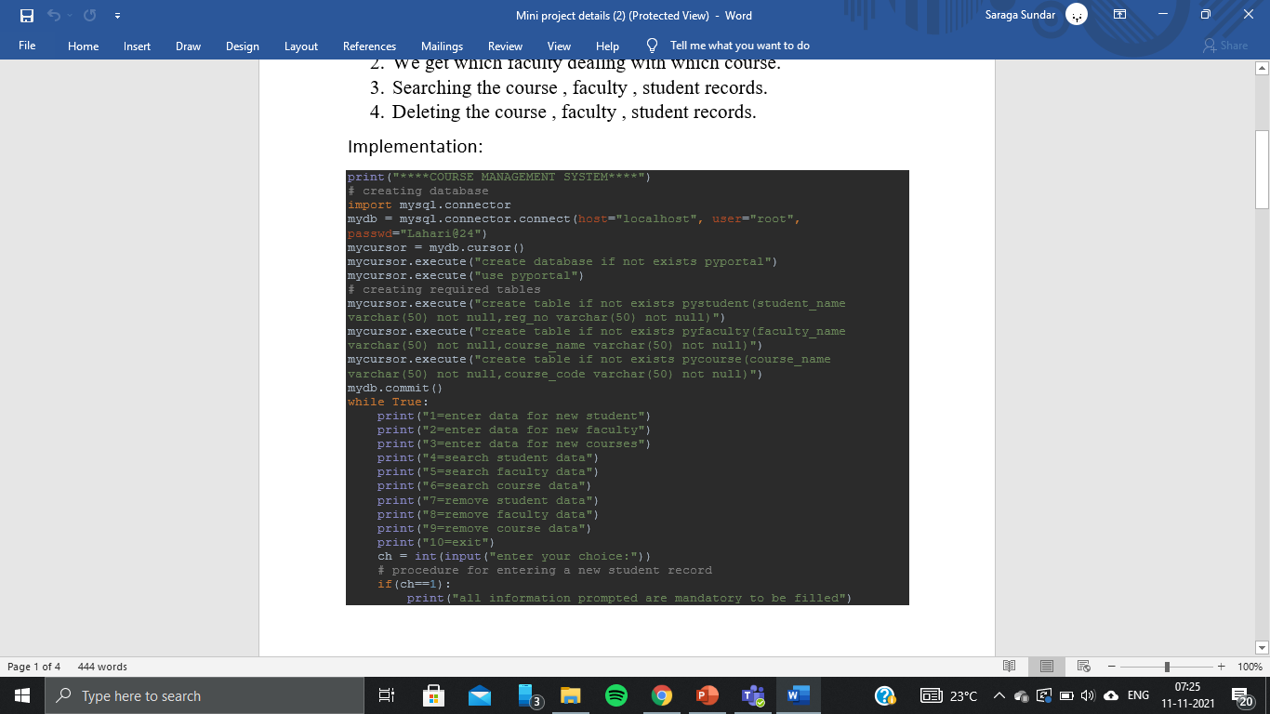
IMPLEMENTAION

Slide 5
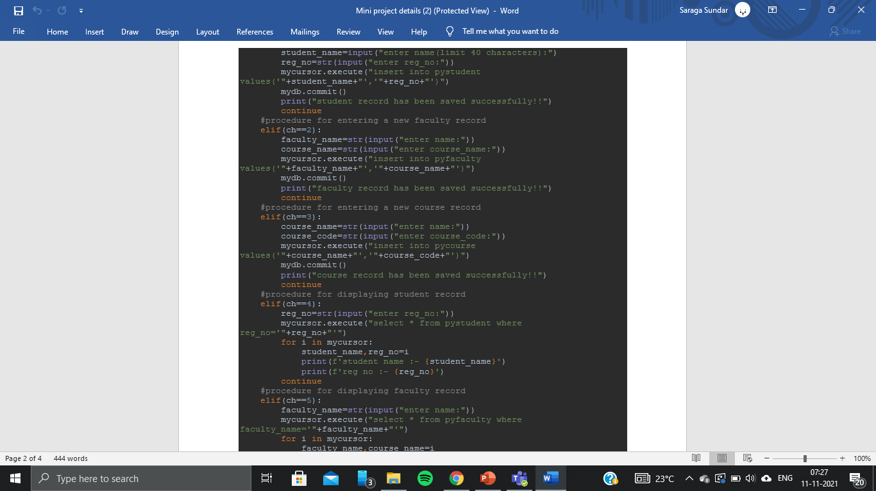

Slide 6
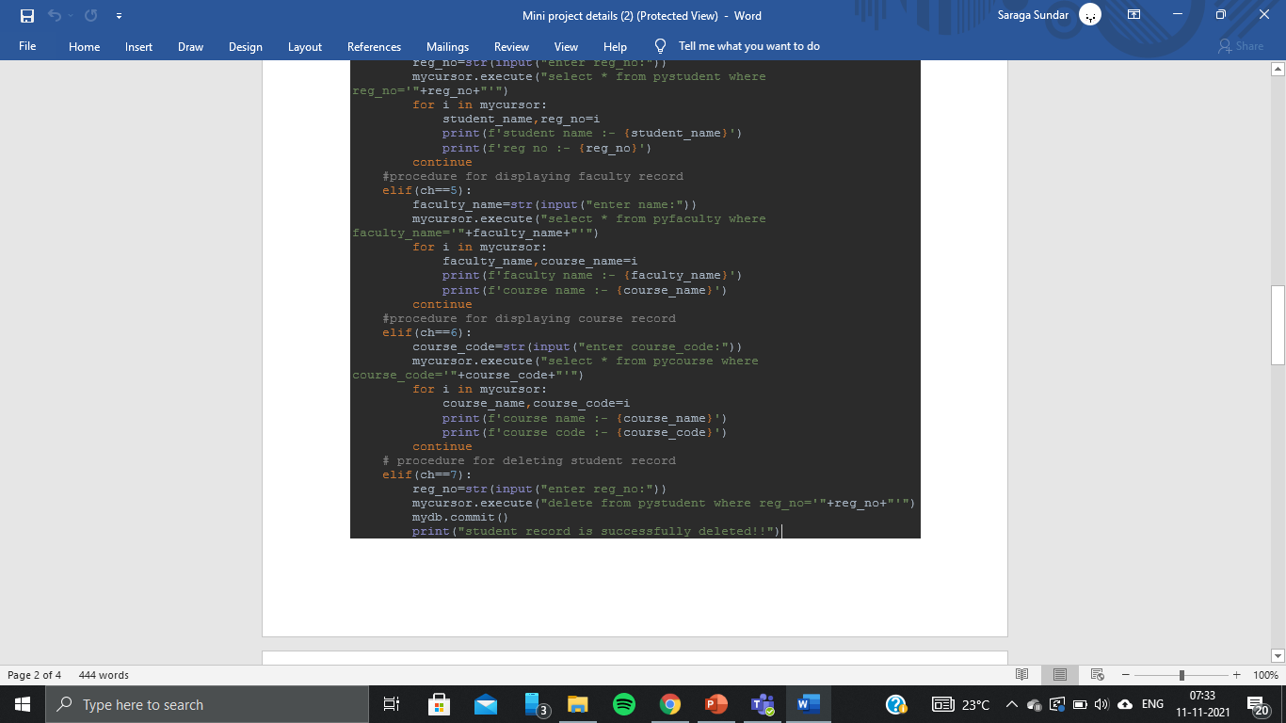
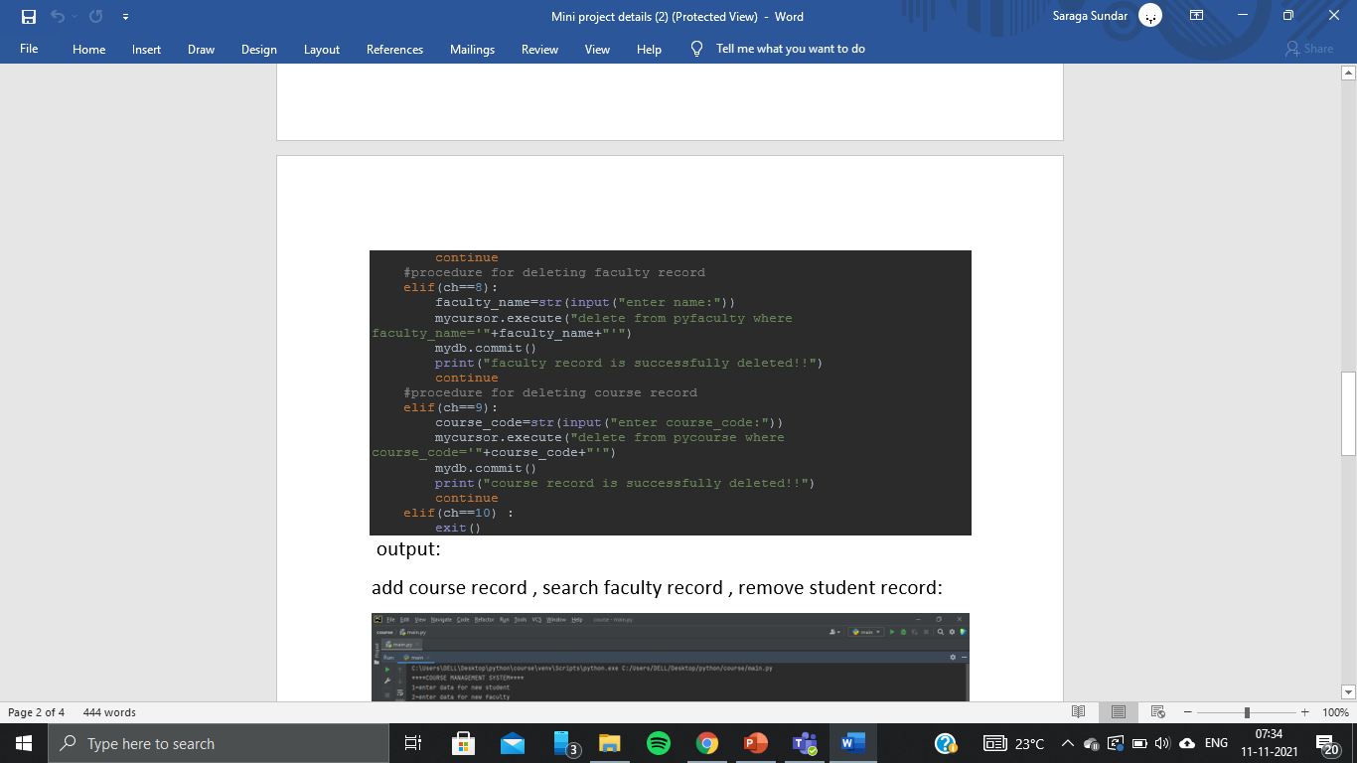

Slide 7
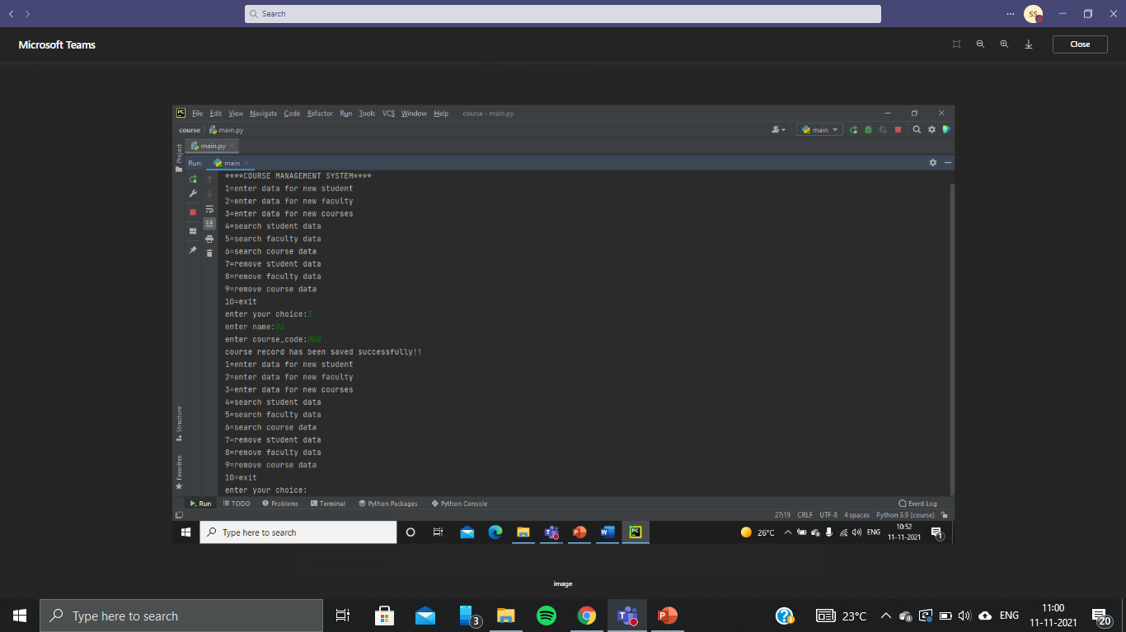
OUTPUT
ADD COURSE, SEARCH FACULTY RECORD, REMOVE STUDENT RECORD

Slide 8
